Slide 1
2 Word Level Analysis 8
2.1 Tokenization, Stemming, Segmentation, Lemmatization, Edit Distance,
Collocations, Finite Automata, Finite State Transducers (FST), Porter
Stemmer, Morphological Analysis, Derivational and Reflectional
Morphology, Regular expression with types.
2.2 N –Grams, Unigrams/Bigrams Language Models, Corpora, Computing the
Probability of Word Sequence, Training and Testing.
https://web.stanford.edu/~jurafsky/slp3/ed3book.pdf

Slide 2
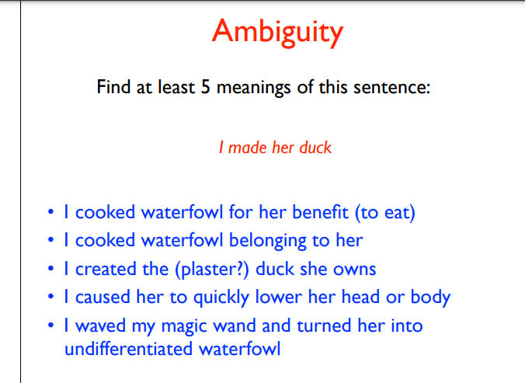

Slide 3
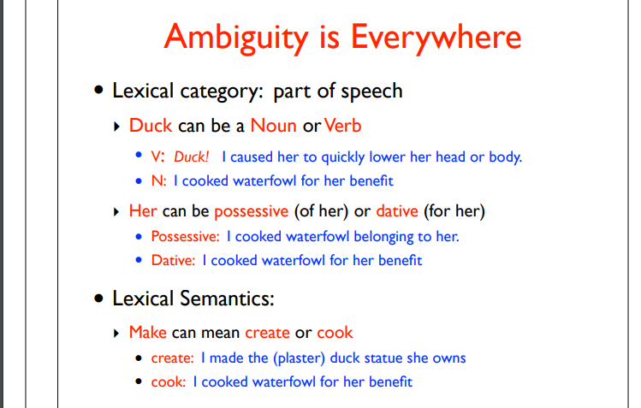

Slide 4
Examples ( Challenges)
"Buffalo buffalo Buffalo buffalo buffalo buffalo Buffalo buffalo"
Will, will Will will Will Will's will?
Police police Police police police police Police police.
Rose rose to put rose roes on her rows of roses
Can can can can can can can can can can
other example
Time flies like an arrow; fruit flies like a banana.
Actions speak louder than words.
Notes:
https://en.wikipedia.org/wiki/List_of_linguistic_example_sentences

Slide 5

NLP fundamentals

Slide 6
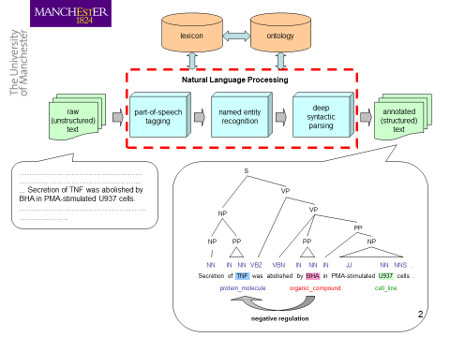

Slide 7
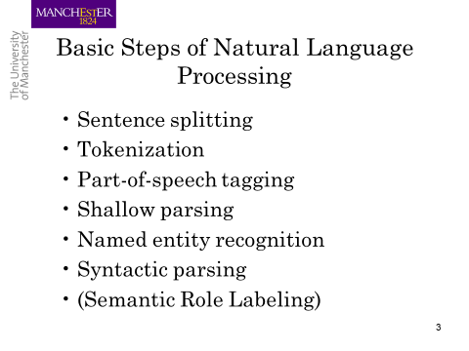

Slide 8
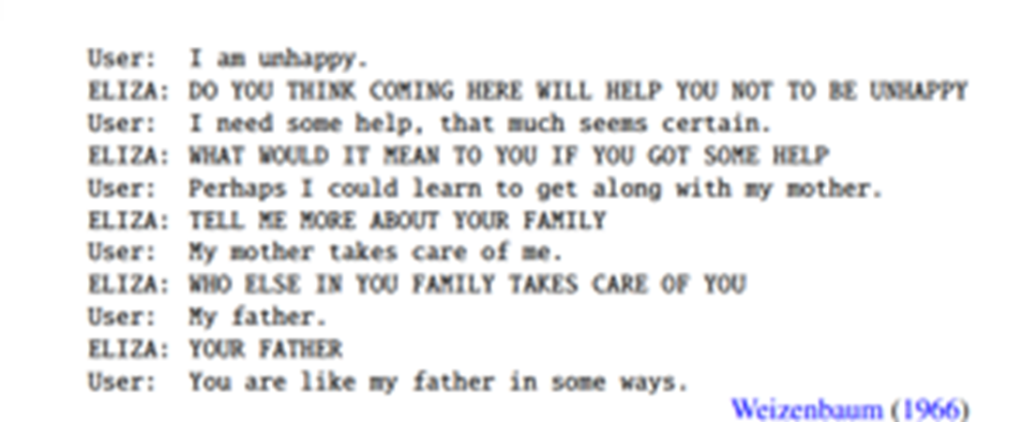

Slide 9
Regular Expressions

Slide 10
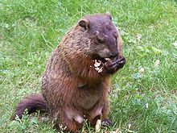
Regular expressions
A formal language for specifying text strings
How can we search for any of these?
woodchuck
woodchucks
Woodchuck
Woodchucks

Slide 11
Regular Expressions: Disjunctions
Letters inside square brackets []
Ranges [A-Z]
Pattern | Matches
[wW]oodchuck | Woodchuck, woodchuck
[1234567890] | Any digit
Pattern | Matches
[A-Z] | An upper case letter | Drenched Blossoms
[a-z] | A lower case letter | my beans were impatient
[0-9] | A single digit | Chapter 1: Down the Rabbit Hole

Slide 12
Regular Expressions: Negation in Disjunction
Negations [^Ss]
Carat means negation only when first in []
Pattern | Matches
[^A-Z] | Not an upper case letter | Oyfn pripetchik
[^Ss] | Neither ‘S’ nor ‘s’ | I have no exquisite reason”
[^e^] | Neither e nor ^ | Look here
a^b | The pattern a carat b | Look up a^b now

Slide 13
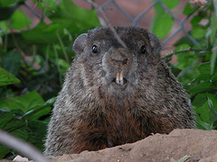
Regular Expressions: More Disjunction
Woodchucks is another name for groundhog!
The pipe | for disjunction
Pattern | Matches
groundhog|woodchuck
yours|mine | yours mine
a|b|c | = [abc]
[gG]roundhog|[Ww]oodchuck
Photo D. Fletcher

Slide 14
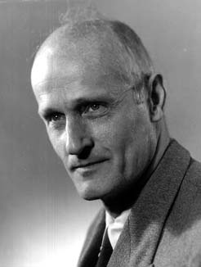
Regular Expressions: ? * + .
Pattern | Matches
colou?r | Optional previous char | color colour
oo*h! | 0 or more of previous char | oh! ooh! oooh! ooooh!
o+h! | 1 or more of previous char | oh! ooh! oooh! ooooh!
baa+ |  | baa baaa baaaa baaaaa
beg.n |  | begin begun begun beg3n
Stephen C Kleene
Kleene *, Kleene +

Slide 15
Regular Expressions: Anchors ^ $
Pattern | Matches
^[A-Z] | Palo Alto
^[^A-Za-z] | 1 “Hello”
\.$ | The end.
.$ | The end? The end!
^ – The caret anchor matches the beginning of the text.
$ – The dollar anchor matches the end of the text.
\. a period Dr.
\* if u want to match *
\^ if u want to match ^
front slash /…………./ wordbound

Slide 16
Example
Find me all instances of the word “the” in a text.
the
Misses capitalized examples
[tT]he
Incorrectly returns other or theology
[^a-zA-Z][tT]he[^a-zA-Z]
-non alphabetical characters before and after the

Slide 17
Errors
The process we just went through was based on fixing two kinds of errors
Matching strings that we should not have matched (there, then, other)
False positives (Type I)
Not matching things that we should have matched (The)
False negatives (Type II)

Slide 18
/(^|[^a-zA-Z])[tT]he([^a-zA-Z]|$)/
^ begining of line
$ end of line
non alphabetic character

Slide 19
Errors cont.
In NLP we are always dealing with these kinds of errors.
Reducing the error rate for an application often involves two antagonistic efforts:
Increasing accuracy or precision (minimizing false positives)
Increasing coverage or recall (minimizing false negatives).

Slide 20
Summary
Regular expressions play a surprisingly large role
Sophisticated sequences of regular expressions are often the first model for any text processing
For many hard tasks, we use machine learning classifiers
But regular expressions can be used as features in the classifiers
Can be very useful in capturing generalizations

Slide 21
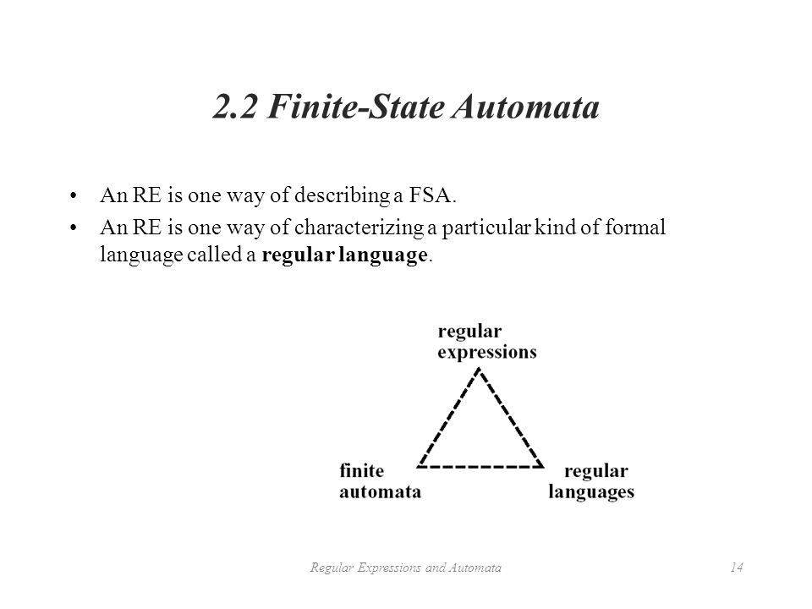

Slide 22
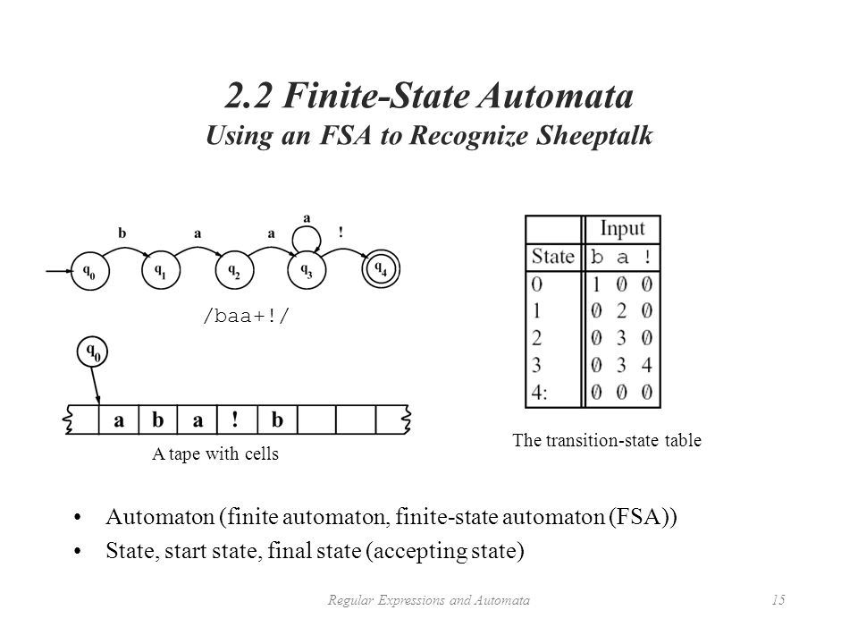

Slide 23
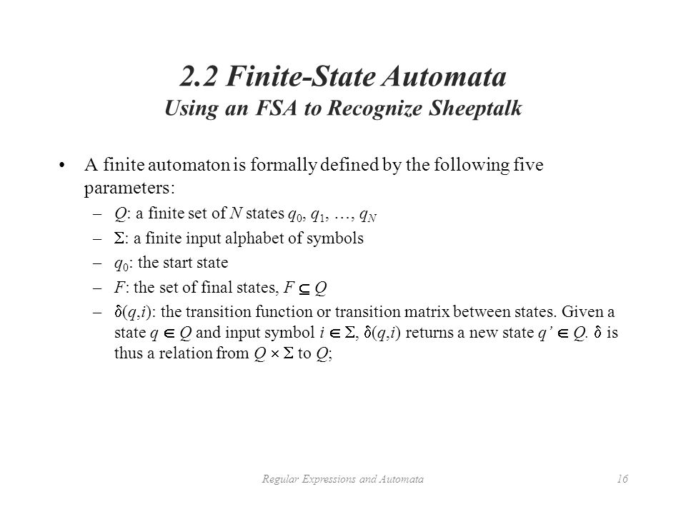

Slide 24
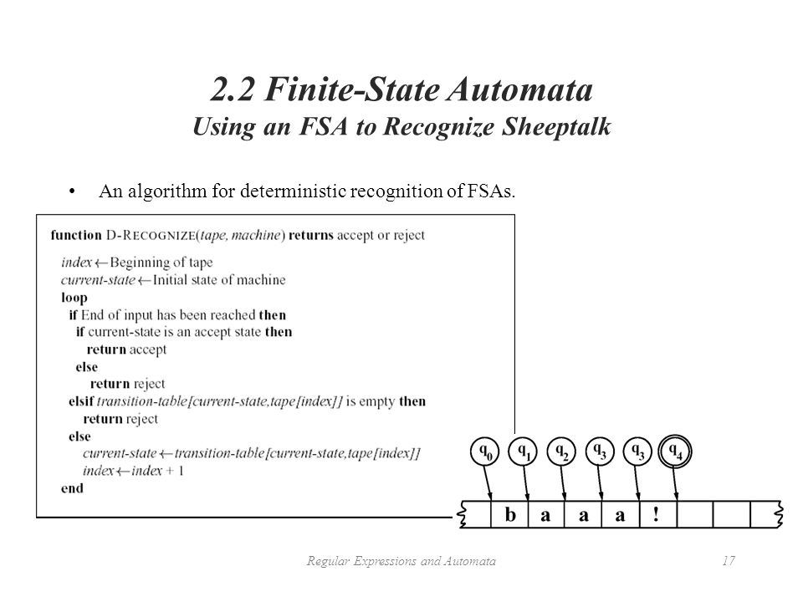

Slide 25
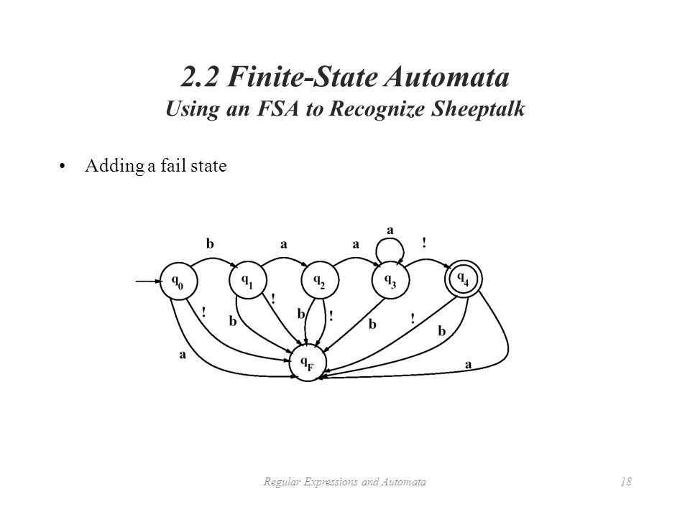

Slide 26
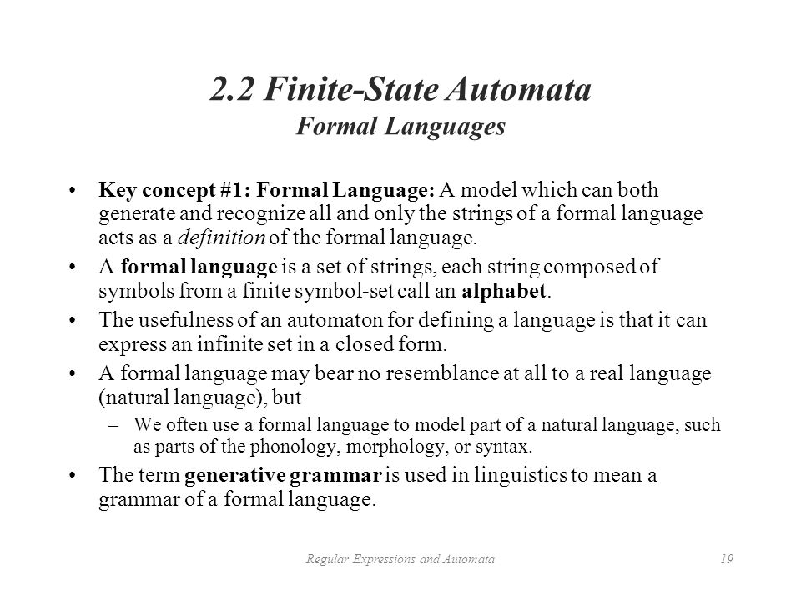

Slide 27
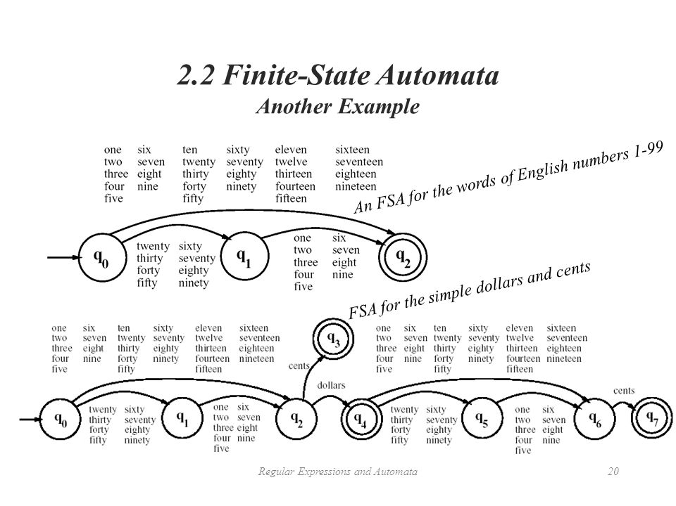

Slide 28
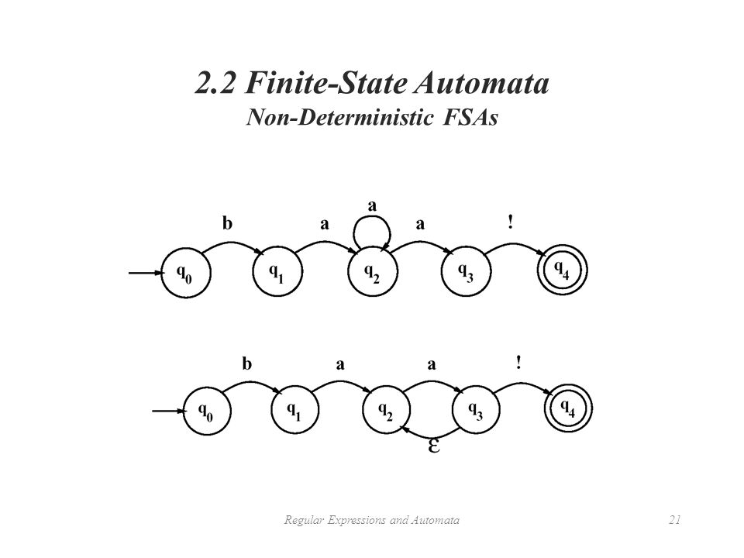

Slide 29
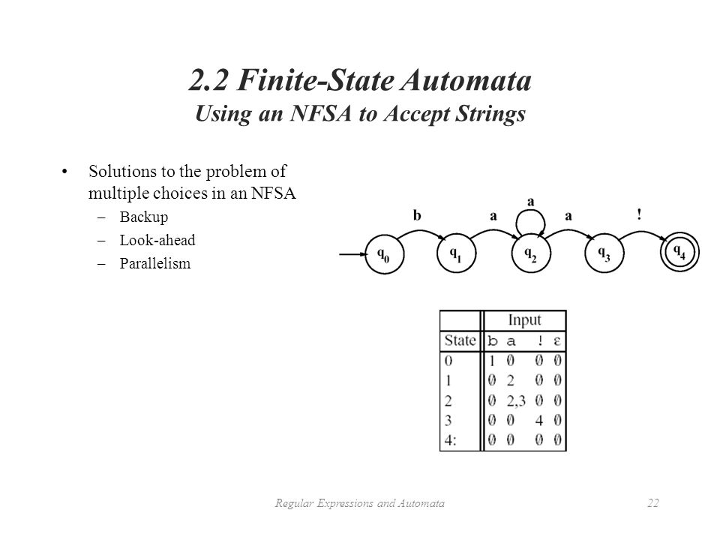

Slide 30
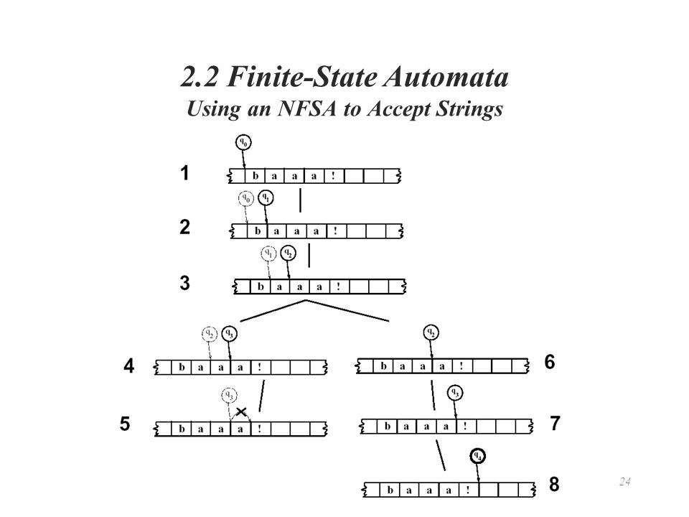

Slide 31
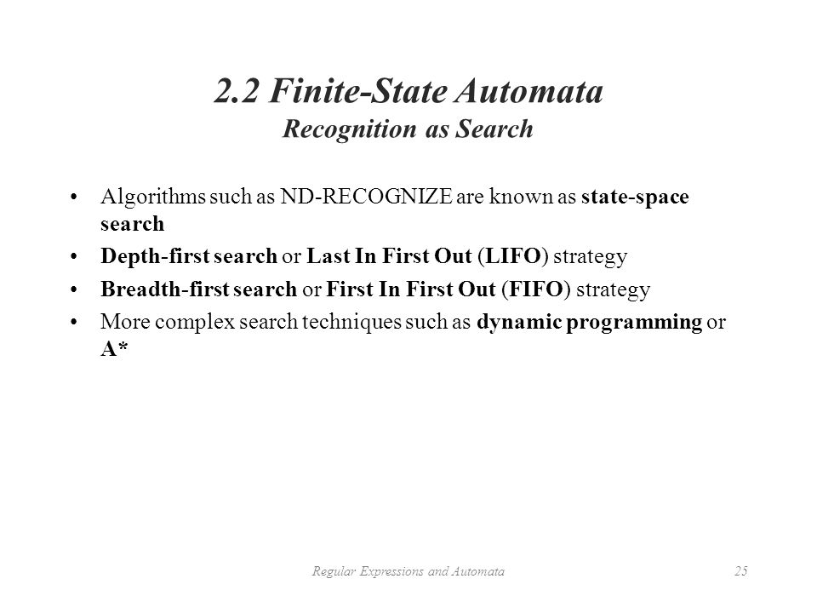

Slide 32
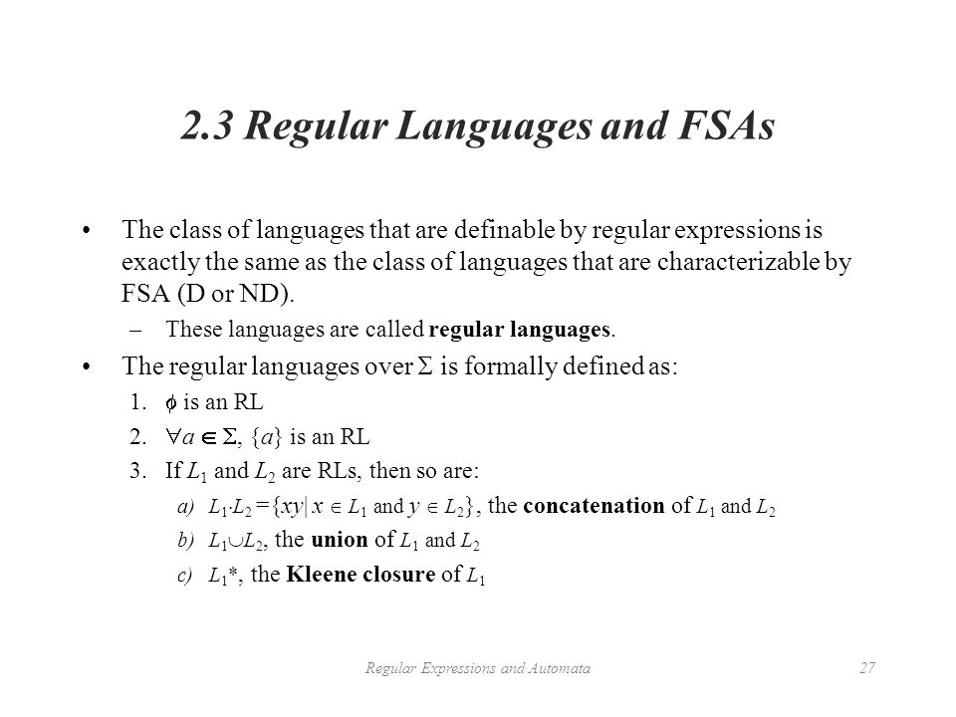

Slide 33
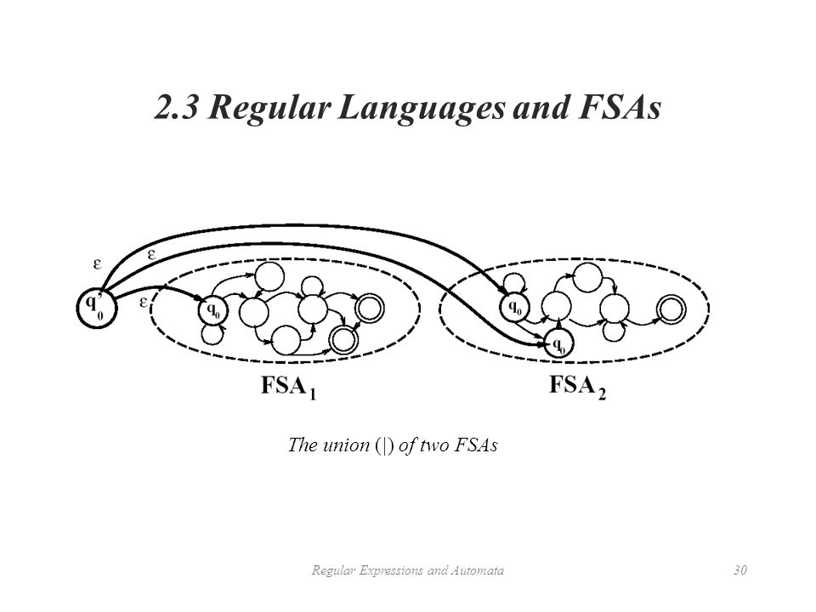

Slide 34
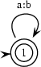
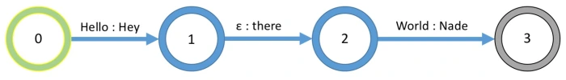
Finite State Transducers
generation mode: It writes a string of as on one tape and a string bs on the other tape. Both strings have the same length.
recognition mode: It accepts when the word on the first tape consists of exactly as many as as the word on the second tape consists of bs.
translation mode (left to right): It reads as from the first tape and writes an b for every a that it reads onto the second tape.
translation mode (right to left): It reads bs from the second tape and writes an a for every f that it reads onto the first tape.
Edges (“Transitions”) have input/output labels
Sometimes, labels are “empty” (indicated here as lowercase epsilon ε)
Traversing through to the end of an FST implies the generation (or indication of) a set of string relations
There is a defined “initial state” (indicated here in green) and 1 or more “final states” (indicated here in gray)

Slide 35
Applications
FSTs are used for a variety of different applications:
Word Inflections. For example, pluralizing words (cat -> cats, dog -> dogs, goose -> geese, etc.).
Morphological Parsing; i.e., extracting the “properties” of a word (e.g., computers -> computer + [Noun] + [Plural])
Simple Word Translation, e.g., translating US English to UK English.
Simple commands made to a computer

Slide 36
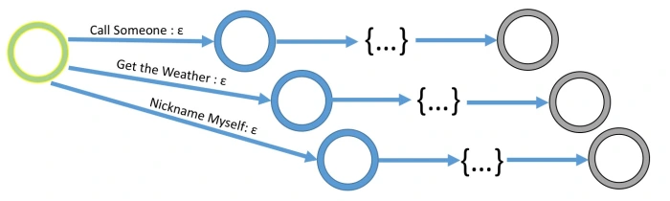
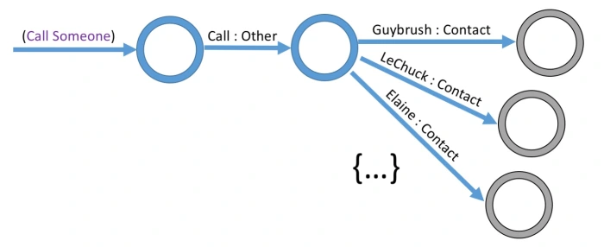
commands made to a computer

Slide 37
Word tokenization

Slide 38
Text Normalization
Most NLP tasks need to do text normalization:
Segmenting/tokenizing words in running text
Normalizing word formats
Segmenting sentences in running text

Slide 39
How many words?
I do uh main- mainly business data processing
Fragments, filled pauses
Seuss’s cat in the hat is different from other cats!
Lemma: same stem, part of speech, rough word sense
cat and cats = same lemma
Wordform: the full inflected surface form
cat and cats = different wordforms

Slide 40
How many words?
they lay back on the San Francisco grass and looked at the stars and their
Type: an element of the vocabulary.
Token: an instance of that type in running text.
How many?
15 tokens …………(or 14)?
13 types …………..(or 12)?

Slide 41
How many words?
N = number of tokens
V = vocabulary = set of types
|V| is the size of the vocabulary
https://books.google.com/ngrams/
Switchboard is a collection of about 2,400 two-sided telephone conversations among 543 speakers (302 male, 241 female) from all areas of the United States.
 | Tokens = N | Types = |V|
Switchboard phone conversations | 2.4 million | 20 thousand
Shakespeare | 884,000 | 31 thousand
Google N-grams | 1 trillion | 13 million

Slide 42
Simple Tokenization in UNIX
(Inspired by Ken Church’s UNIX for Poets.)
Given a text file, output the word tokens and their frequencies
tr -sc "A-Za-z" "\n" < sample.txt
| sort
| uniq –c
1945 A
72 AARON
19 ABBESS
5 ABBOT
... ...
Change all non-alpha to newlines
Sort in alphabetical order
Merge and count each type
25 Aaron
6 Abate
1 Abates
5 Abbess
6 Abbey
3 Abbot
.... …

Slide 43
The first step: tokenizing
tr -sc "A-Za-z" "\n" < sample.txt | head
THE
SONNETS
by
William
Shakespeare
From
fairest
creatures
We
...

Slide 44
The second step: sorting
tr -sc "A-Za-z" "\n" < sample.txt | sort | head
A
A
A
A
A
A
A
A
A
...

Slide 45
More counting
Merging upper and lower case
tr "A-Z" "a-z" < sample.txt | tr -sc "A-Za-z" "\n" | sort | uniq –c
Sorting the counts
tr "A-Z" "a-z" < sample.txt | tr -sc "A-Za-z" "\n" | sort | uniq -c | sort -n -r
23243 the
22225 i
18618 and
16339 to
15687 of
12780 a
12163 you
10839 my
10005 in
8954 d
What happened here?

Slide 46
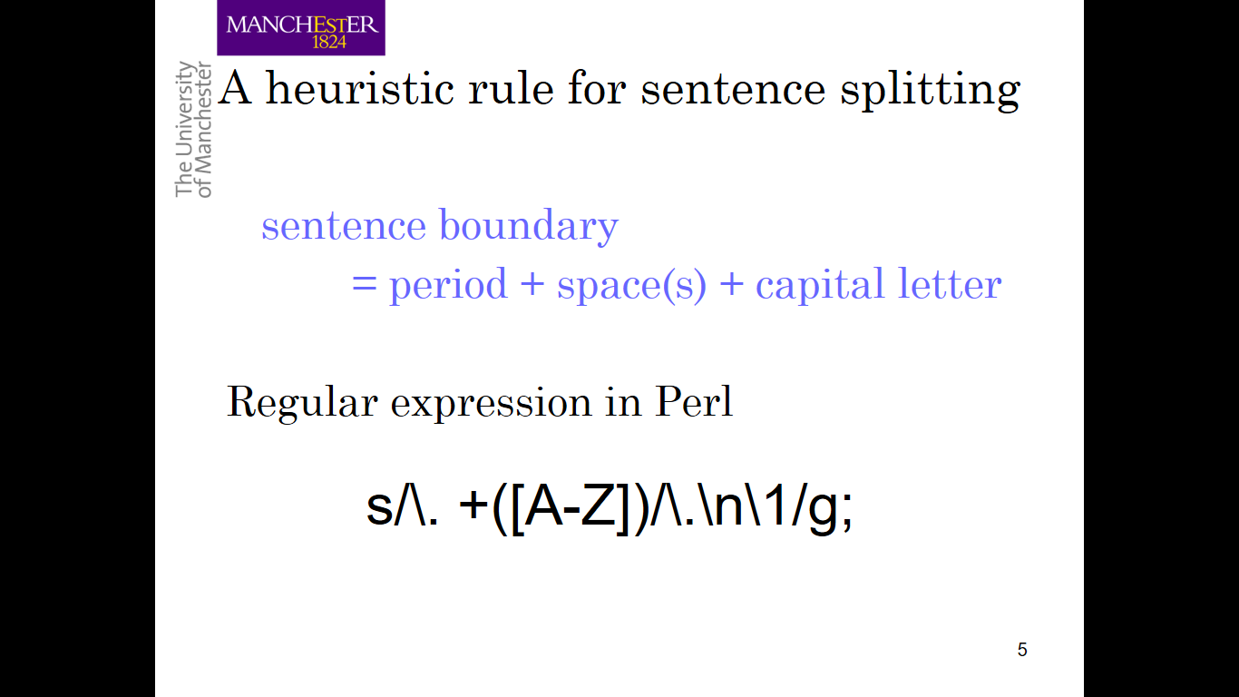

Slide 47
Issues in Tokenization
Finland’s capital → Finland Finlands Finland’s ?
what’re, I’m, isn’t → What are, I am, is not
Hewlett-Packard → Hewlett Packard ?
state-of-the-art → state of the art ?
Lowercase → lower-case lowercase lower case ?
San Francisco → one token or two?
m.p.h., PhD. → ??

Slide 48
Tokenization: language issues
French
L'ensemble → one token or two?
L ? L’ ? Le ?
Want l’ensemble to match with un ensemble
German noun compounds are not segmented
Lebensversicherungsgesellschaftsangestellter
‘life insurance company employee’
German information retrieval needs compound splitter

Slide 49
Tokenization: language issues
Chinese and Japanese no spaces between words:
莎拉波娃现在居住在美国东南部的佛罗里达。
莎拉波娃 现在 居住 在 美国 东南部 的 佛罗里达
Sharapova now lives in US southeastern Florida
Further complicated in Japanese, with multiple alphabets intermingled
Dates/amounts in multiple formats
フォーチュン500社は情報不足のため時間あた$500K(約6,000万円)
Katakana
Hiragana
Kanji
Romaji
End-user can express query entirely in hiragana!

Slide 50
Word Normalization and Stemming

Slide 51
Normalization
Need to “normalize” terms
Information Retrieval: indexed text & query terms must have same form.
We want to match U.S.A. and USA
We implicitly define equivalence classes of terms
e.g., deleting periods in a term
Alternative: asymmetric expansion:
Enter: window Search: window, windows
Enter: windows Search: Windows, windows, window
Enter: Windows Search: Windows
Potentially more powerful, but less efficient

Slide 52
Case folding
Applications like IR: reduce all letters to lower case
Since users tend to use lower case
Possible exception: upper case in mid-sentence?
e.g., General Motors
Fed vs. fed
SAIL vs. sail
For sentiment analysis, MT, Information extraction
Case is helpful (US versus us is important)

Slide 53
Lemmatization
Reduce inflections or variant forms to base form
am, are, is → be
car, cars, car's, cars' → car
the boy's cars are different colors → the boy car be different color
Lemmatization: have to find correct dictionary headword form
Machine translation
Spanish quiero (‘I want’), quieres (‘you want’) same lemma as querer ‘want’

Slide 54
Morphology
Morphemes:
The small meaningful units that make up words
Stems: The core meaning-bearing units
Affixes: Bits and pieces that adhere to stems
Often with grammatical functions

Slide 55
Stemming
Reduce terms to their stems in information retrieval
Stemming is crude chopping of affixes
language dependent
e.g., automate(s), automatic, automation all reduced to automat.
for example compressed
and compression are both
accepted as equivalent to
compress.
for exampl compress and
compress ar both accept
as equival to compress

Slide 56
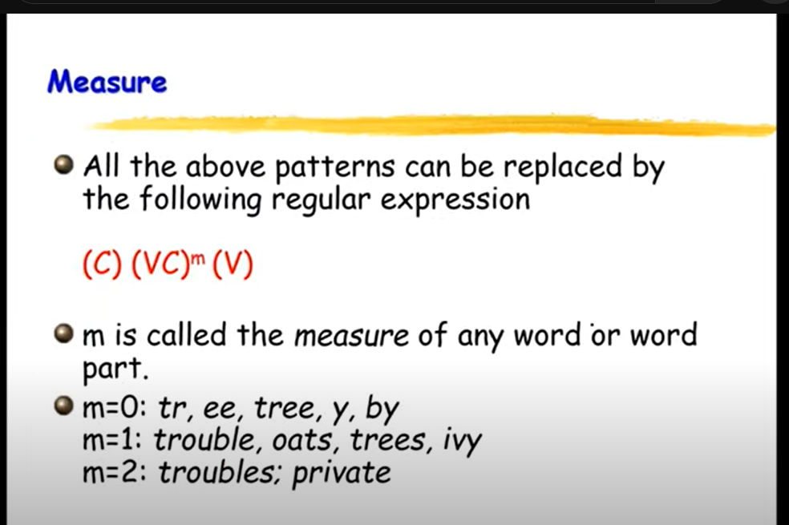
Compression word in regular expression

Slide 57
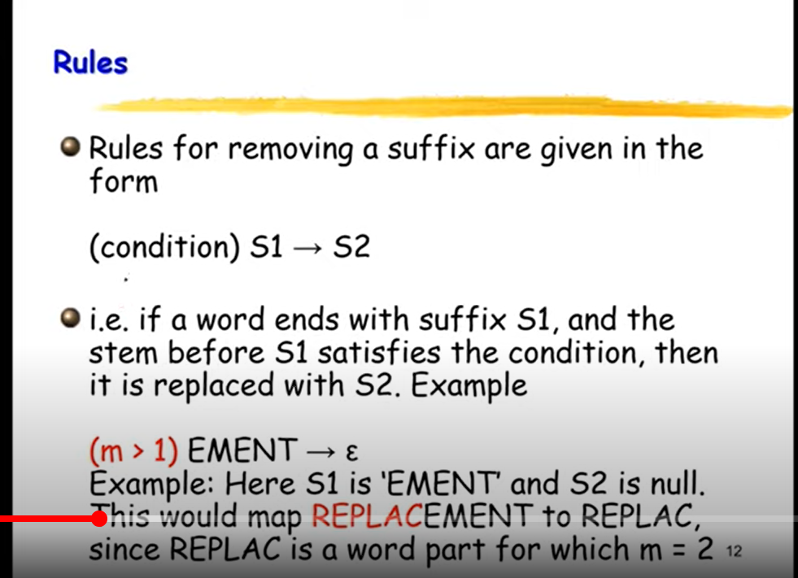

Slide 58
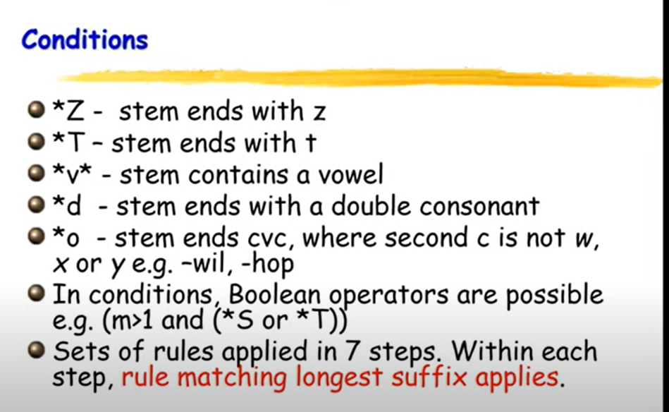

Slide 59
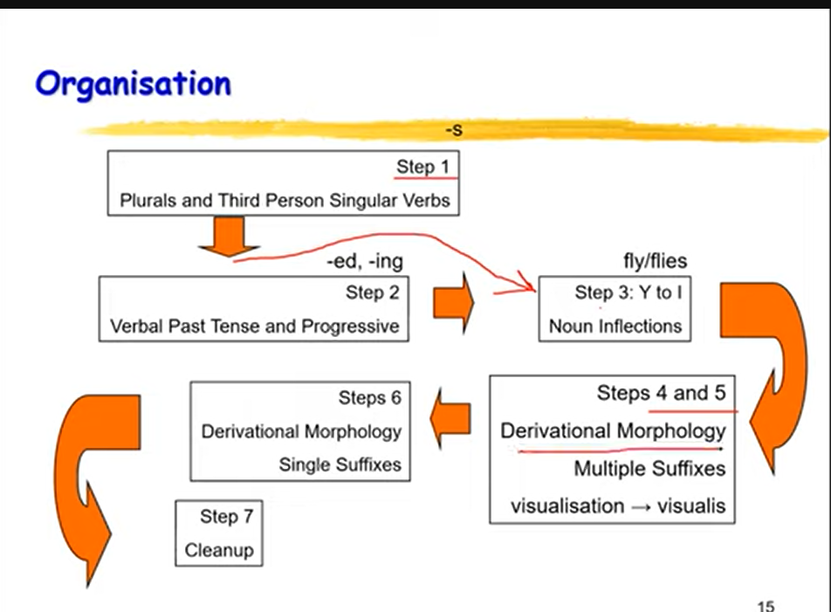
Notes:
https://www.youtube.com/watch?v=7zq8tAHRTiA

Slide 60
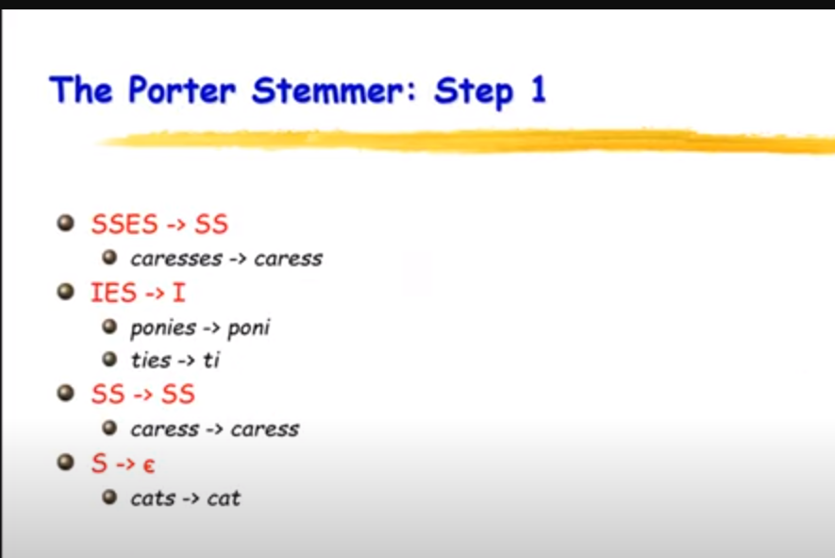

Slide 61
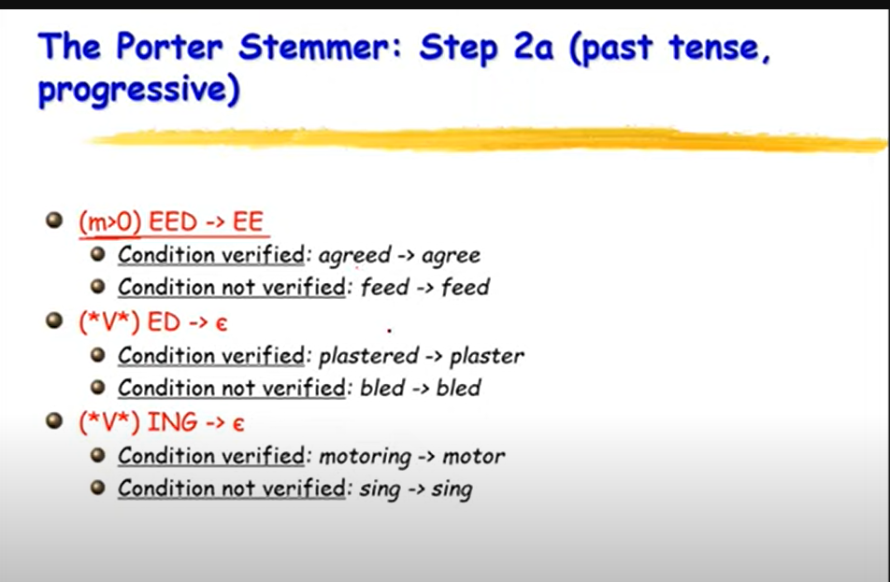

Slide 62
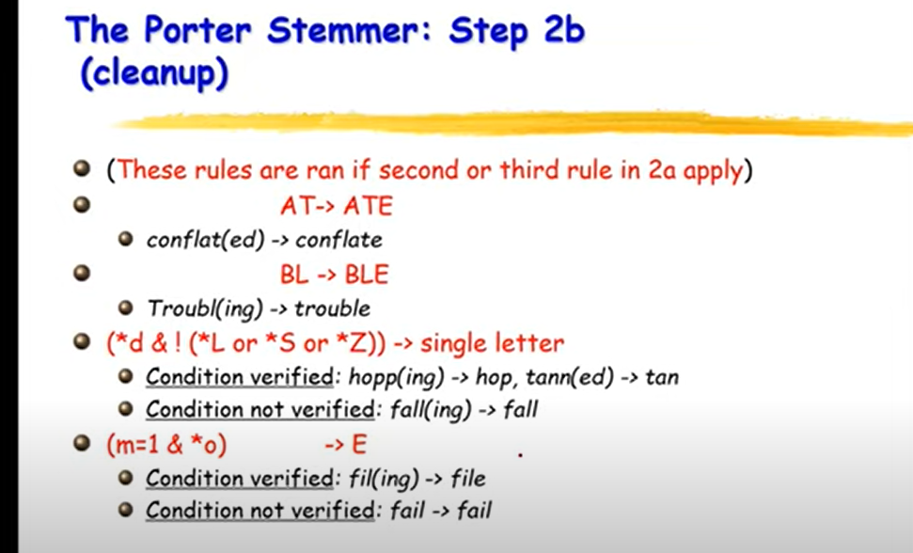

Slide 63
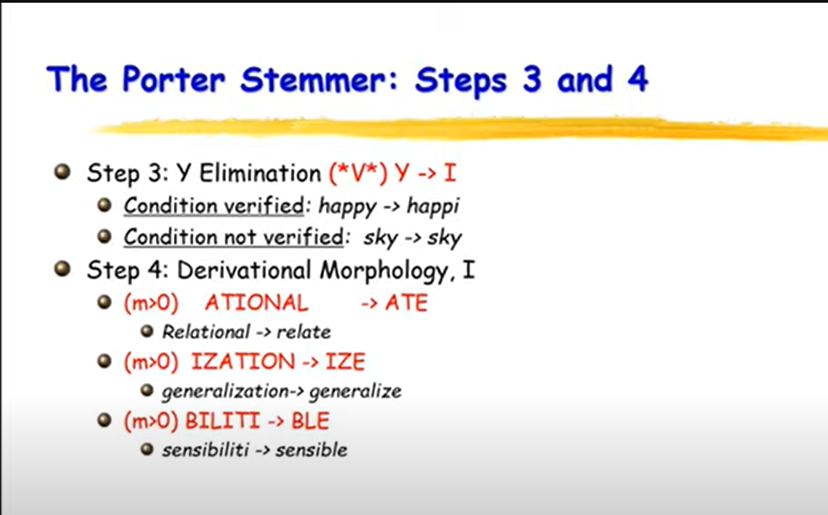

Slide 64
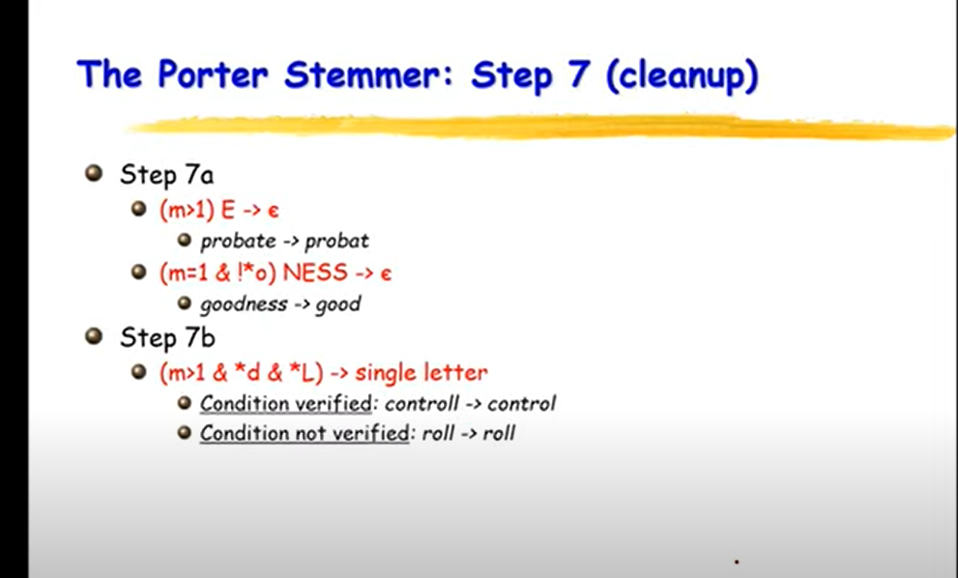

Slide 65
Porter’s algorithm The most common English stemmer
Step 1a
sses → ss caresses → caress
ies → i ponies → poni
ss → ss caress → caress
s → ø cats → cat
Step 1b
(*v*)ing → ø walking → walk
sing → sing
(*v*)ed → ø plastered → plaster
…
Step 2 (for long stems)
ational→ ate relational→ relate
izer→ ize digitizer → digitize
ator→ ate operator → operate
…
Step 3 (for longer stems)
al → ø revival → reviv
able → ø adjustable → adjust
ate → ø activate → activ
…

Slide 66
Viewing morphology in a corpus Why only strip –ing if there is a vowel?
(*v*)ing → ø walking → walk
sing → sing

Slide 67
Viewing morphology in a corpus Why only strip –ing if there is a vowel?
(*v*)ing → ø walking → walk
sing → sing
tr -sc "A-Za-z" "\n" < sample.txt | grep "ing$" | sort | uniq -c | sort –nr
tr -sc "A-Za-z" "\n" < sample.txt | grep "[aeiou].*ing$" | sort | uniq -c | sort –nr
1312 King
548 being
541 nothing
388 king
375 bring
358 thing
307 ring
152 something
145 coming
130 morning
548 being
541 nothing
152 something
145 coming
130 morning
122 having
120 living
117 loving
116 Being
102 going

Slide 68
Dealing with complex morphology is sometimes necessary
Some languages require complex morpheme segmentation
Turkish
Uygarlastiramadiklarimizdanmissinizcasina
`(behaving) as if you are among those whom we could not civilize’
Uygar `civilized’ + las `become’
+ tir `cause’ + ama `not able’
+ dik `past’ + lar ‘plural’
+ imiz ‘p1pl’ + dan ‘abl’
+ mis ‘past’ + siniz ‘2pl’ + casina ‘as if’

Slide 69
Minimum Edit Distance
Definition of Minimum Edit Distance

Slide 70
How similar are two strings?
Spell correction
The user typed “graﬀe” Which is closest?
graf
graft
grail
giraﬀe
Computational Biology
Align two sequences of nucleotides
AGGCTATCACCTGACCTCCAGGCCGATGCCC TAGCTATCACGACCGCGGTCGATTTGCCCGAC
Resulting alignment:
-AGGCTATCACCTGACCTCCAGGCCGA--TGCCC---
TAG-CTATCAC--GACCGC--GGTCGATTTGCCCGAC
Also for Machine Translation, Information Extraction, Speech Recognition

Slide 71
Edit Distance
The minimum edit distance between two strings
Is the minimum number of editing operations
Insertion
Deletion
Substitution
Needed to transform one into the other

Slide 72

Minimum Edit Distance
Two strings and their alignment:

Slide 73
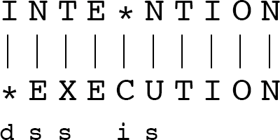
Minimum Edit Distance
If each operation has cost of 1
Distance between these is 5
If substitutions cost 2 (Levenshtein)
Distance between them is 8

Slide 74
Alignment in Computational Biology
Given a sequence of bases
AGGCTATCACCTGACCTCCAGGCCGATGCCC TAGCTATCACGACCGCGGTCGATTTGCCCGAC
An alignment:
-AGGCTATCACCTGACCTCCAGGCCGA--TGCCC--- TAG-CTATCAC--GACCGC--GGTCGATTTGCCCGAC
Given two sequences, align each letter to a letter or gap

Slide 75
Other uses of Edit Distance in NLP
Evaluating Machine Translation and speech recognition
R Spokesman confirms
H Spokesman said
S
senior government adviser was shot
adviser was shot dead
I
the senior
I D
Named Entity Extraction and Entity Coreference
IBM Inc. announced today
IBM profits
Stanford President John Hennessy announced yesterday
for Stanford University President John Hennessy

Slide 76
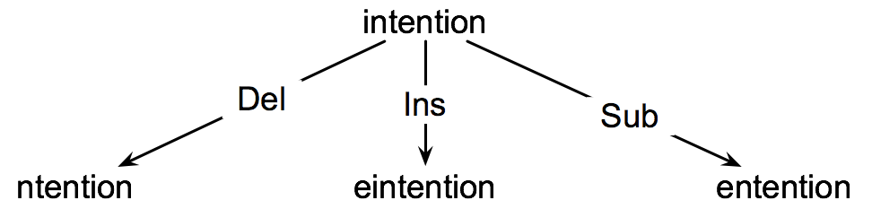
How to ﬁnd the Min Edit Distance?
Searching for a path (sequence of edits) from the start string to the final string:
Initial state: the word we’re transforming
Operators: insert, delete, substitute
Goal state: the word we’re trying to get to
Path cost: what we want to minimize: the number of edits
8

Slide 77
Minimum Edit as Search
But the space of all edit sequences is huge!
We can’t aﬀord to navigate naïvely
Lots of distinct paths wind up at the same state.
We don’t have to keep track of all of them
Just the shortest path to each of those revisted states.
9

Slide 78
Deﬁning Min Edit Distance
For two strings
X of length n
Y of length m
We define D(i,j)
the edit distance between X[1..i] and Y[1..j]
i.e., the first i characters of X and the first j characters of Y
The edit distance between X and Y is thus D(n,m)

Slide 79
Minimum Edit Distance
Definition of Minimum Edit Distance

Slide 80
Minimum Edit Distance
Computing Minimum Edit Distance

Slide 81
Dynamic Programming for Minimum Edit Distance
Dynamic programming: A tabular computation of D(n,m)
Solving problems by combining solutions to subproblems.
Bottom-­‐up
We compute D(i,j) for small i,j
And compute larger D(i,j) based on previously computed smaller values
i.e., compute D(i,j) for all i (0 < i < n) and j (0 < j < m)

Slide 82
Deﬁning Min Edit Distance (Levenshtein)
Initialization D(i,0) = i D(0,j) = j
Recurrence Relation:
For each i = 1…M
For each j
D(i,j)=
= 1…N
D(i-1,j) + 1
min D(i,j-1) + 1
D(i-1,j-1) +
2; if X(i) ≠ Y(j)
0; if X(i) = Y(j)
Termination:
D(N,M) is distance

Slide 83
The Edit Distance Table
N | 9
O | 8
I | 7
T | 6
N | 5
E | 4
T | 3
N | 2
I | 1
# | 0 | 1 | 2 | 3 | 4 | 5 | 6 | 7 | 8 | 9
 | # | E | X | E | C | U | T | I | O | N

Slide 84
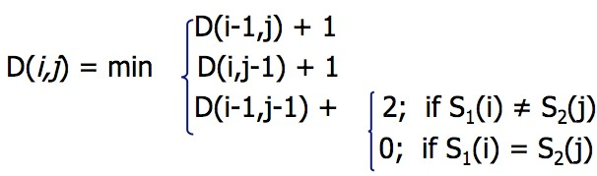
The Edit Distance Table
N | 9
O | 8
I | 7
T | 6
N | 5
E | 4
T | 3
N | 2
I | 1
# | 0 | 1 | 2 | 3 | 4 | 5 | 6 | 7 | 8 | 9
 | # | E | X | E | C | U | T | I | O | N

Slide 85
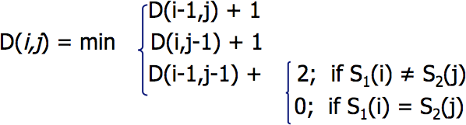
Edit Distance
N | 9
O | 8
I | 7
T | 6
N | 5
E | 4
T | 3
N | 2
I | 1
# | 0 | 1 | 2 | 3 | 4 | 5 | 6 | 7 | 8 | 9
 | # | E | X | E | C | U | T | I | O | N

Slide 86
The Edit Distance Table
N | 9 | 8 | 9 | 10 | 11 | 12 | 11 | 10 | 9 | 8
O | 8 | 7 | 8 | 9 | 10 | 11 | 10 | 9 | 8 | 9
I | 7 | 6 | 7 | 8 | 9 | 10 | 9 | 8 | 9 | 10
T | 6 | 5 | 6 | 7 | 8 | 9 | 8 | 9 | 10 | 11
N | 5 | 4 | 5 | 6 | 7 | 8 | 9 | 10 | 11 | 10
E | 4 | 3 | 4 | 5 | 6 | 7 | 8 | 9 | 10 | 9
T | 3 | 4 | 5 | 6 | 7 | 8 | 7 | 8 | 9 | 8
N | 2 | 3 | 4 | 5 | 6 | 7 | 8 | 7 | 8 | 7
I | 1 | 2 | 3 | 4 | 5 | 6 | 7 | 6 | 7 | 8
# | 0 | 1 | 2 | 3 | 4 | 5 | 6 | 7 | 8 | 9
 | # | E | X | E | C | U | T | I | O | N

Slide 87
Sentence Segmentation and Decision Trees

Slide 88
Sentence Segmentation
!, ? are relatively unambiguous
Period “.” is quite ambiguous
Sentence boundary
Abbreviations like Inc. or Dr.
Numbers like .02% or 4.3
Build a binary classifier
Looks at a “.”
Decides EndOfSentence/NotEndOfSentence
Classifiers: hand-written rules, regular expressions, or machine-learning

Slide 89
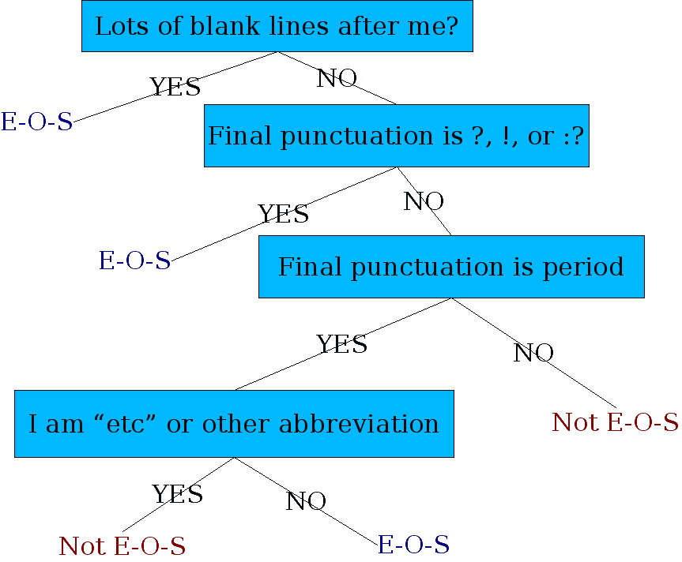
Determining if a word is end-of-sentence: a Decision Tree

Slide 90
More sophisticated decision tree features
Case of word with “.”: Upper, Lower, Cap, Number
Case of word after “.”: Upper, Lower, Cap, Number
Numeric features
Length of word with “.”
Probability(word with “.” occurs at end-of-s)
Probability(word after “.” occurs at beginning-of-s)

Slide 91
Implementing Decision Trees
A decision tree is just an if-then-else statement
The interesting research is choosing the features
Setting up the structure is often too hard to do by hand
Hand-building only possible for very simple features, domains
For numeric features, it’s too hard to pick each threshold
Instead, structure usually learned by machine learning from a training corpus

Slide 92
Decision Trees and other classifiers
We can think of the questions in a decision tree
as features that could be exploited by any kind of classifier:
Logistic regression
SVM
Neural Nets
etc.

Slide 93
Part-of-speech (POS) tagging

Slide 94
Open class (lexical) words
Nouns
Verbs
Adjectives
old older oldest
Proper
Common
Main
Adverbs
slowly
IBM
Italy
cat / cats
snow
see
registered
Numerals
… more
122,312
one fifth
Closed class (functional)
Modals
Determiners
the some
can
had
Prepositions
to with
Conjunctions
and or
Particles
off up
… more
Pronouns
he its
Interjections
Ow Eh

Slide 95
POS Tagging
Words often have more than one POS: back
The back door = JJ
On my back = NN
Win the voters back = RB
Promised to back the bill = VB
The POS tagging problem is to determine the POS tag for a particular instance of a word.

Slide 96
POS Tagging
Input: Plays well with others
Ambiguity: NNS/VBZ UH/JJ/NN/RB IN NNS
Output: Plays/VBZ well/RB with/IN others/NNS
Uses:
Text-to-speech (how do we pronounce “lead”?)
Can write regexps like (Det) Adj* N+ over the output for phrases, etc.
As input to or to speed up a full parser
If you know the tag, you can back off to it in other tasks
Penn Treebank POS tags

Slide 97
POS tagging performance
How many tags are correct? (Tag accuracy)
About 97% currently
But baseline is already 90%
Baseline is performance of stupidest possible method
Tag every word with its most frequent tag
Tag unknown words as nouns
Partly easy because
Many words are unambiguous
You get points for them (the, a, etc.) and for punctuation marks!

Slide 98
Deciding on the correct part of speech can be difficult even for people
Mrs/NNP Shaefer/NNP never/RB got/VBD around/RP to/TO joining/VBG
All/DT we/PRP gotta/VBN do/VB is/VBZ go/VB around/IN the/DT corner/NN
Chateau/NNP Petrus/NNP costs/VBZ around/RB 250/CD

Slide 99
How difficult is POS tagging?
About 11% of the word types in the Brown corpus are ambiguous with regard to part of speech
But they tend to be very common words. E.g., that
I know that he is honest = IN
Yes, that play was nice = DT
You can’t go that far = RB
40% of the word tokens are ambiguous

Slide 100
Sources of information
What are the main sources of information for POS tagging?
Knowledge of neighboring words
Bill saw that man yesterday
NNP NN DT NN NN
VB VB(D) IN VB NN
Knowledge of word probabilities
man is rarely used as a verb….
The latter proves the most useful, but the former also helps
Notes:
These were the features of HMM taggers

Slide 101
More and Better Features 🡺 Feature-based tagger
Can do surprisingly well just looking at a word by itself:
Word the: the → DT
Lowercased word Importantly: importantly → RB
Prefixes unfathomable: un- → JJ
Suffixes Importantly: -ly → RB
Capitalization Meridian: CAP → NNP
Word shapes 35-year: d-x → JJ
Then build a maxent (or whatever) model to predict tag
Maxent P(t|w): 93.7% overall / 82.6% unknown
Notes:
Doing better

Slide 102
Use of POS tags in downstream NLP tasks
Features in text classifiers (e.g. spam / not spam)
Noun-phrase chunking
United Nations
NNP NNP

Slide 103
POS taggers
Stanford POS tagger
https://nlp.stanford.edu/software/tagger.shtml
Natural Language Tool Kit (NLTK)
https://www.nltk.org
Illinois POS tagger
http://cogcomp.org/page/software_view/POS

Slide 104
Syntactic parsing

Slide 105
Two views of linguistic structure
1. Constituency (phrase structure)
2. Dependency structure

Slide 106
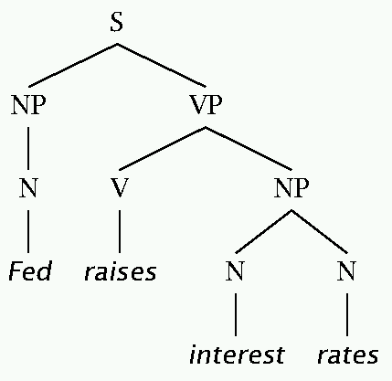
Two views of linguistic structure: 1. Constituency (phrase structure)
Phrase structure organizes words into nested constituents.
How do we know what is a constituent? (Not that linguists don’t argue about some cases.)
Distribution: a constituent behaves as a unit that can appear in different places:
John talked [to the children] [about drugs].
John talked [about drugs] [to the children].
*John talked drugs to the children about
Substitution/expansion/pro-forms:
I sat [on the box/right on top of the box/there].
Coordination, regular internal structure, no intrusion,
fragments, semantics, …

Slide 107
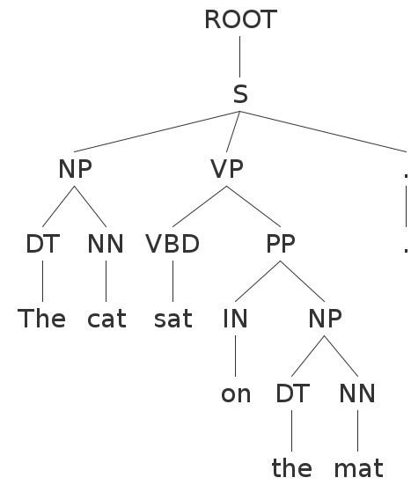
Parse Trees
“The cat sat on the mat”

Slide 108
Parse Trees
In bracket notation:
(ROOT
(S
(NP (DT the) (NN cat))
(VP (VBD sat)
(PP (IN on)
(NP (DT the) (NN mat))))))

Slide 109
Grammars
There are typically multiple ways to produce the same sentence. Consider the statement by Groucho Marx:
“While I was in Africa, I shot an elephant in my pajamas”
“How he got into my pajamas, I don’t know”

Slide 110
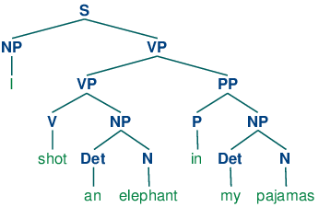
Parse Trees
“…,I shot an elephant in my pajamas” -what people hear first

Slide 111
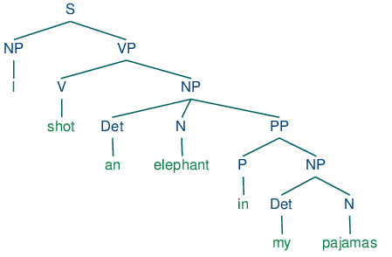
Parse Trees
Groucho’s version

Slide 112
Grammars
Its also possible to have “sentences” inside other sentences…
S 🡪 NP VP
VP 🡪 VB NP SBAR
SBAR 🡪 IN S

Slide 113
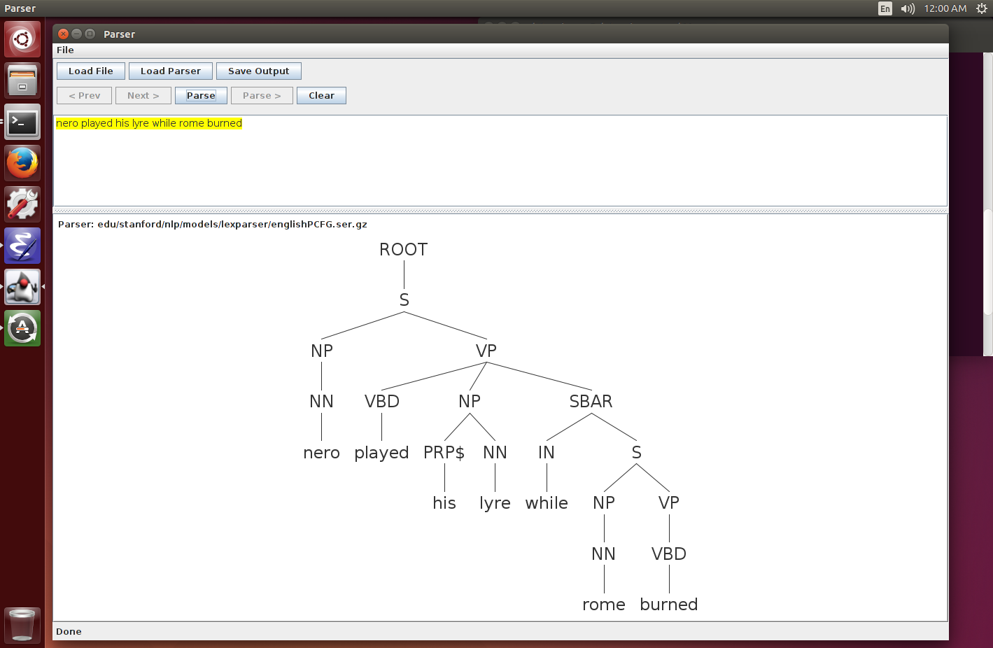
Recursion in Grammars
“Nero played his lyre while Rome burned”.

Slide 114
Headed phrase structure
VP → … VB* …
NP → … NN* …
ADJP → … JJ* …
ADVP → … RB* …
SBAR(Q) → S|SINV|SQ → … NP VP …
Plus minor phrase types:
QP (quantifier phrase in NP), CONJP (multi word constructions: as well as), INTJ (interjections), etc.

Slide 115
PCFGs
Complex sentences can be parsed in many ways, most of which make no sense or are extremely improbable (like Groucho’s example).
Probabilistic Context-Free Grammars (PCFGs) associate and learn probabilities for each rule:
S 🡪 NP VP 0.8
S 🡪 NP VP PP 0.2
The parser then tries to find the most likely sequence of productions that generate the given sentence. This adds more realistic “world knowledge” and generally gives much better results.
Most state-of-the-art parsers these days use PCFGs.

Slide 116
Systems
NLTK: Python-based NLP system. Many modules, good visualization tools, but not quite state-of-the-art performance.
Stanford Parser: Another comprehensive suite of tools (also POS tagger), and state-of-the-art accuracy. Has the definitive dependency module.
Berkeley Parser: Slightly higher parsing accuracy (than Stanford) but not as many modules.
Note: high-quality dependency parsing is usually very slow, but see: https://github.com/dlwh/puck

Slide 117
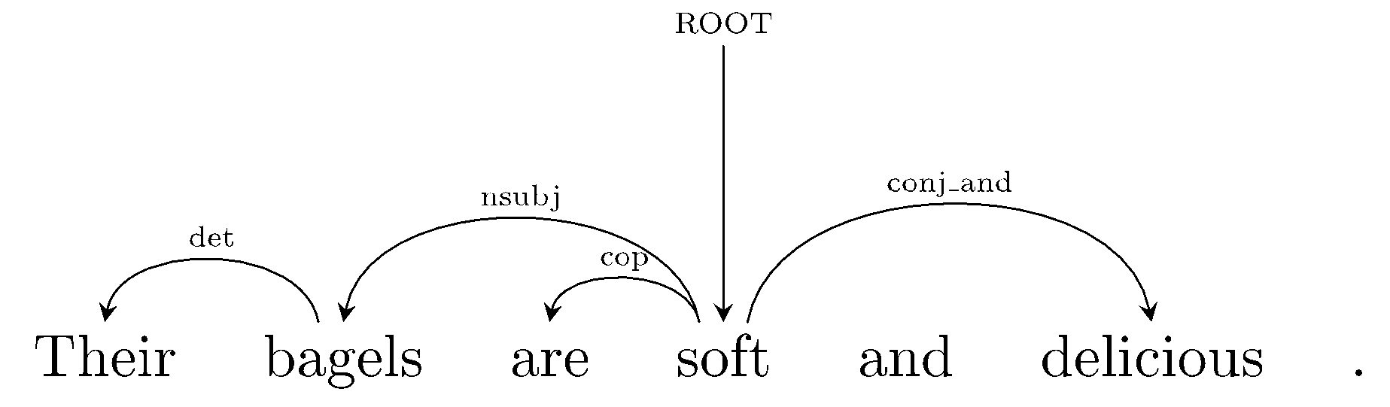
Two views of linguistic structure: 2. Dependency structure
Dependency structure shows which words depend on (modify or are arguments of) which other words.

Slide 118
“Their bagels are soft and delicious.”
root ( ROOT-0 , soft-4 )
nmod:poss ( bagels-2 , Their-1 )
nsubj ( soft-4 , bagels-2 )
nsubj ( delicious-6 , bagels-2 )
cop ( soft-4 , are-3 )
cc ( soft-4 , and-5 )
conj:and ( soft-4 , delicious-6 )
Typed dependency (relationship) between two words: head and modifier. Also known as governor and dependent.

Slide 119
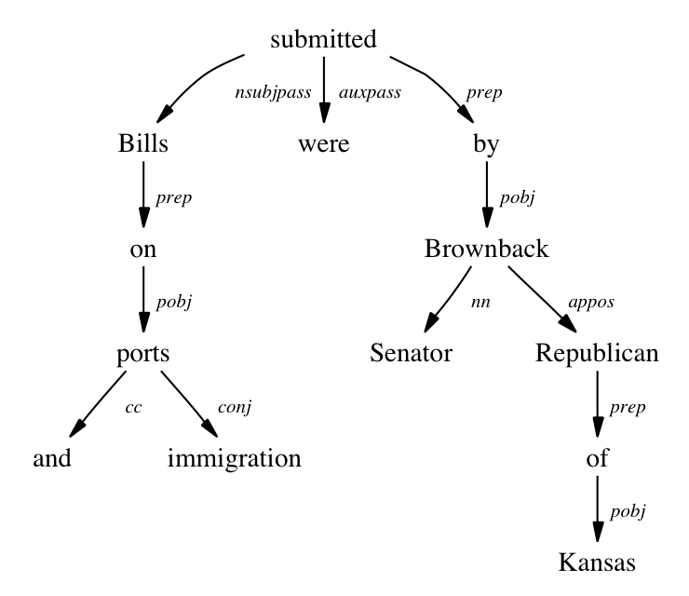
Dependency Parsing
Dependency parses may be non-binary, and structure type is encoded in links rather than nodes:

Slide 120
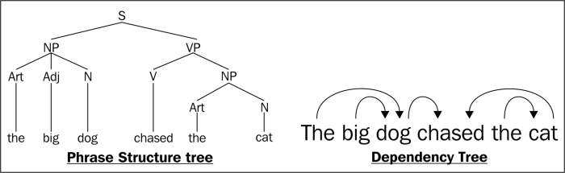
Comparison between constituent (phrase) and dependency trees

Slide 121
Dependency parser
Stanford dependency parser
https://nlp.stanford.edu/software/stanford-dependencies.shtml

Slide 122
Statistical parsing applications
Statistical parsers are now robust and widely used in larger NLP applications:
High precision question answering [Pasca and Harabagiu SIGIR 2001]
Improving biological named entity finding [Finkel et al. JNLPBA 2004]
Syntactically based sentence compression [Lin and Wilbur 2007]
Extracting opinions about products [Bloom et al. NAACL 2007]
Improved interaction in computer games [Gorniak and Roy 2005]
Helping linguists find data [Resnik et al. BLS 2005]
Source sentence analysis for machine translation [Xu et al. 2009]
Relation extraction systems [Fundel et al. Bioinformatics 2006]

